Slide 1
SHOE ORDERING SYSTEM Presentation by: Hope Njoki Nyambura, Mary Wanjiku Muiruri,Shuel Kiin, Peter Maina Nduta, Irene Nyathika Kibiku, Eric Muriuki, Brian Mburu Kibande Irungu, Nicole Wambui, Ian Muiruri Muthoni NIBS Technical College.

Slide 2
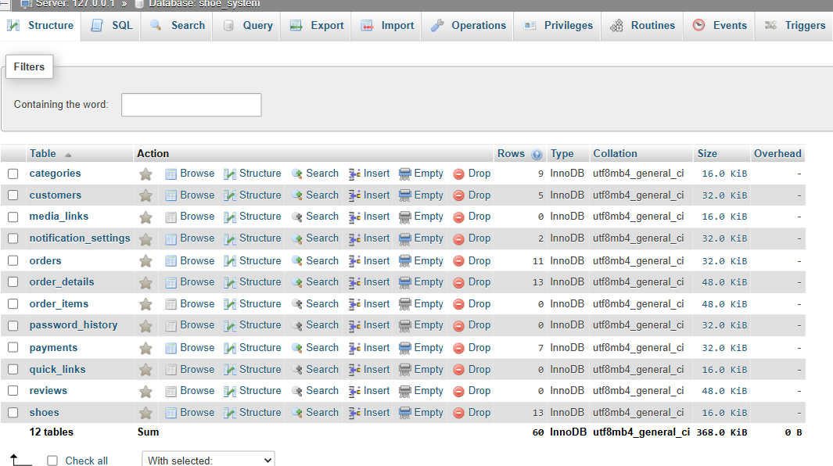
Components of the system
Database and its appropriate tables

Slide 3
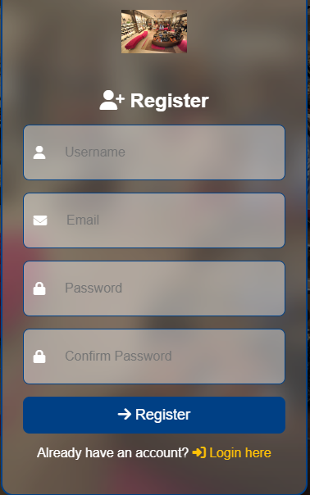
2.Frontend-Used html,css and javasript to create forms,let’s begin customer side:
a)Registration form-for customers it allows if they’re new members to register

Slide 4
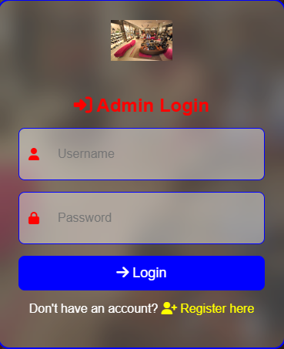
b)Login form-Allowing members to login after they have already successfully registered

Slide 5
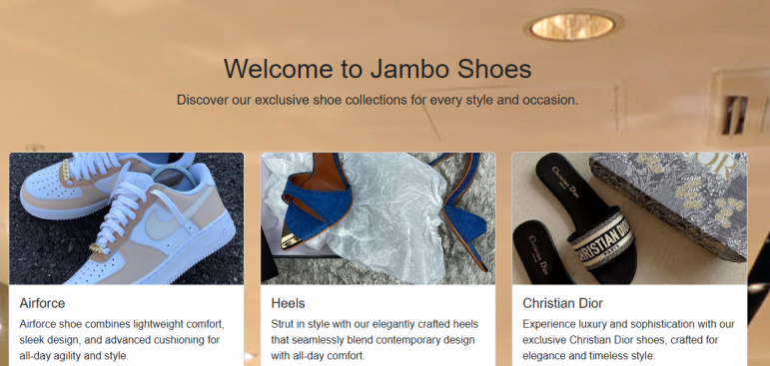
c)Move to the dashboard-where shoes are displayed and relevant information about them

Slide 6

d)Logout-For either a customer or admin they can if they want to leave by clicking such a button

Slide 7
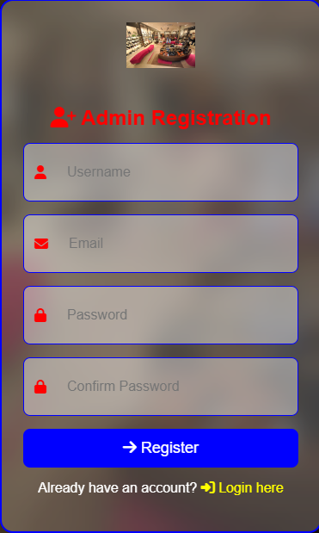
Admin side
a)Admin_Registration form

Slide 8
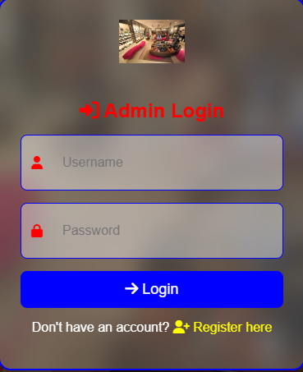
b)Admin_Login Form

Slide 9
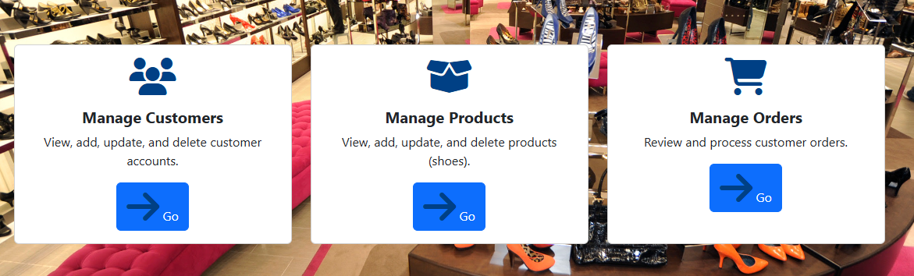
c)Admin_Dashboard-Highlights actions admin carries out eg.manage customers etc.

Slide 10

d)Admin_logout-An admin can also logout just like a customer

Slide 11
Main difference between customer and admin side
Customer Side
Admin Side
Uses present data hence can only use or read
Can create,delete,
edit and also read data

Slide 12
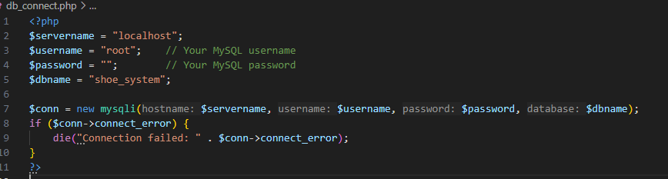
3. Backend-For connection we used php to link the forms with the database created eg.db_connect.php

Slide 13
END OF THE PRESENTATION

